Slide 1
Title________________________________
[University Logo attach here]
By
Student Name_______________________
Registration Number -________
Project Proposal
BSCS
Instructor Name________________

Slide 2
Background and Justification
Despite the growth in solar energy adoption, significant challenges persist in maximizing energy yield and maintaining system efficiency.
Many studies lack detailed real-world implementation results
There is a need for deeper exploration into how AI and IoT can be leveraged to create more intuitive and user-friendly solar mobile applications that enhance user engagement and satisfaction.

Slide 3
Problem Statement
Previous research in the field of solar energy has predominantly focused on predictions of solar energy output and photovoltaic (PV) system performance, largely ignoring the nuanced user-level variables that can significantly affect energy production.
There is a notable gap in understanding how local environmental factors like wind and temperature, as well as issues related to PV system maintenance such as sensor efficiency and cleanliness, impact the energy output.
This research aims to bridge this gap by investigating the specific causes of reduced solar energy production at the user level, including the efficiency and operational health of solar sensors and the impact of environmental and maintenance-related factors.
By identifying these variables, this study will provide actionable insights that could enhance the efficiency and reliability of solar energy systems in residential and commercial settings.

Slide 4
Aims and Objectives
To develop and validate an AI-enabled IoT mobile application that enhances the efficiency of solar energy system and reduce downtime of solar system working through advanced monitoring, predictive maintenance, and user-centric features.

Slide 5
Previous Research Gap
Identified Research Gap: Many studies overlook the precise causes of energy yield reductions under various environmental parameters such as solar irradiance, wind speed, wind direction, PV temperature, ambient temperature, and humidity.
Potential Causes of Energy Reduction: Factors contributing to decreased energy yields may include panel degradation, soiling, shading, and equipment inefficiencies.
Lack of Focused Research: There is a notable absence of detailed research focused on systematically analyzing the root causes of energy yield reductions, highlighting a significant gap in existing literature.

Slide 6
Research questions
RQ1: How can the integration of IoT devices for real-time data streaming be optimized to improve the effectiveness of data analysis in solar PV systems?
RQ2: How accurate are AI-driven models in identifying changes in energy patterns, predicting potential system failures, and assisting in performance degradation analysis?
RQ3: What are the impacts of sensor-output discrepancies on the efficiency and reliability of solar energy systems?

Slide 7
Objectives
RQ1: To ensure that the system can handle real-time data streaming from IoT devices for effective analysis.
RO2: To ensure AI models predict accurately for maintenance, performance degradation analysis, and fault diagnosis based on real-time and historical data to identify changings in energy patterns, predict potential system failures.
RO3: To assess the effect of sensor-output related and other issues on the efficiency and reliability of solar energy output.

Slide 8
Significance of Research
Real Time Insight of sudden drop in energy production and fluctuations
Predictive maintenance alerts to users
Performance degradation analysis from long term data
Fault diagnosis and root cause analysis based on historical data
Recommendation for corrective action to users using Machine learning
Visualization of real time data on user demand

Slide 9
Methodology
To achieve the outlined aims and objectives
The following strategic steps will be undertaken:
System Design and Integration
Development of Predictive Maintenance Algorithms
User Interface Development
Application implementation with AI and IoT

Slide 10
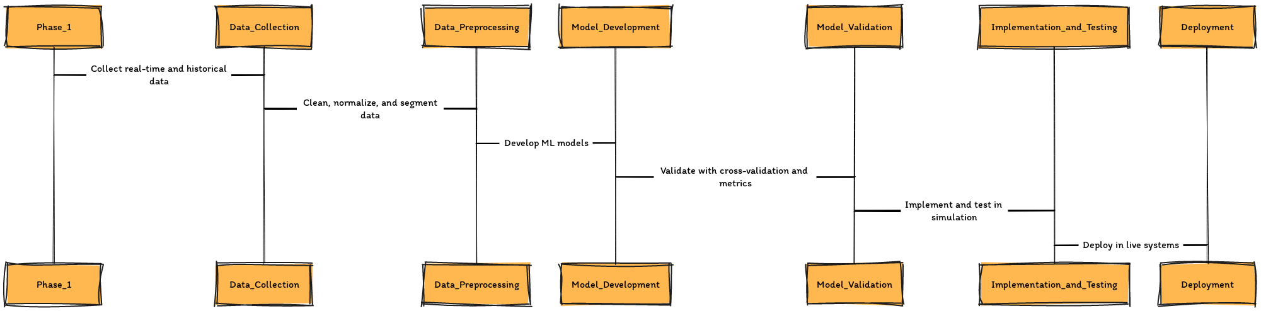
Methodology plan

Slide 11
Importance
It is worth pursuing because it promises to significantly enhance the efficiency and reduce cost of renewable energy sources, which is crucial for achieving broader sustainability goals.
The project not only has the potential to revolutionize the solar energy sector but also serves as a model for other renewable energy technologies, promoting wider adoption and smarter energy practices globally.

Slide 12
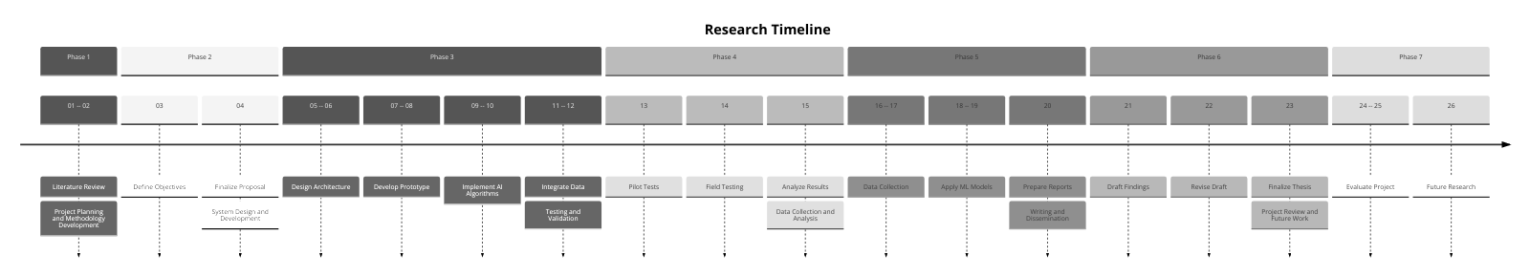
Timeline

Slide 13
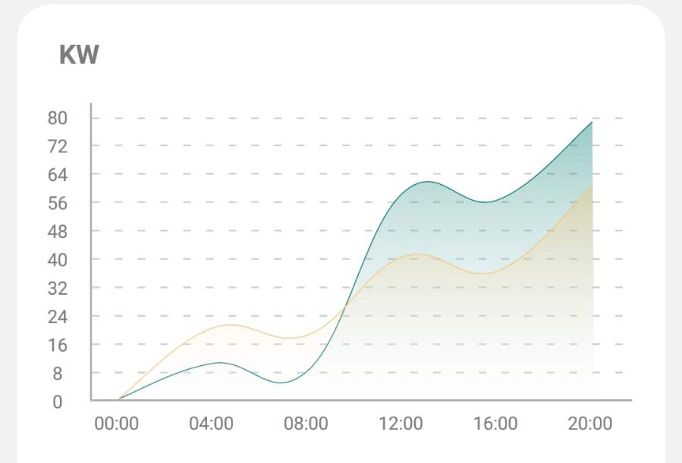
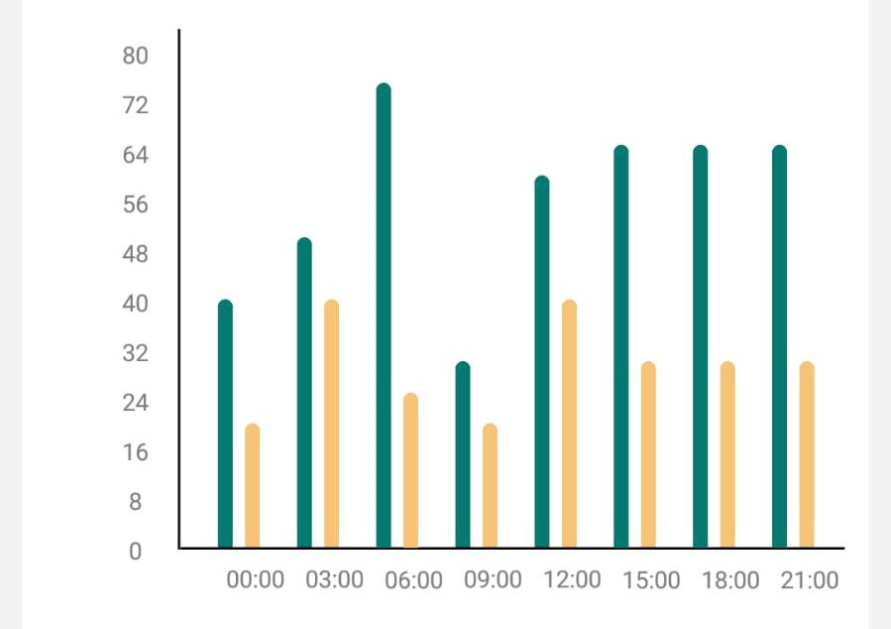
Real Time insights

Slide 14
Conclusion
Purpose of Proposed Research: The research aims to develop an AI-enabled IoT mobile application for remote monitoring and maintenance that optimizes solar system performance and provides detailed analytics.
Benefits of the AI-enabled Application: The application allows solar system operators and users to:
Engage directly with real-time data and insights.
Understand specific reasons for energy yield declines.
Make informed and timely decisions to maximize energy output.
Impact on Solar Energy Management: This research promises to be a pivotal advancement in solar energy management by seamlessly connecting general maintenance tasks with targeted actions to enhance energy efficiency and output.

